Slide 1

Flood & Cyclone Early Warning System
A web-based system for real-time alerts and centralized disaster information.

Slide 2

Team Members
Hasibul Islam Hemel
0432310005101005
Azher Mahmud Fahim
0432310005101028
Arafat Al Sani
0432310005101049
Md. Shoyaif Rahman
0432310005101050

Slide 3





Objective
Rapid Alerts
Property Protection
Send timely, accurate evacuation alerts
Provide early warnings to reduce building harm
Community Preparedness
Coordinated Response
Deliver actionable information for readiness
Centralize tools for fast team collaboration

Slide 4

Our Purpose
Life Safety
Give people enough time to evacuate and move to safe places.
Property Protection
To help minimize damage to infrastructure, homes, and assets by giving communities sufficient time to secure their properties and take protective measures.
Preparedness
Help communities and authorities get ready with shelters, relief, and emergency services.
Timely Information
To deliver accurate and immediate alerts regarding impending floods and cyclones, ensuring that all stakeholders have the necessary data for swift decision-making.

Slide 5
Features
Real-time Alerts
Based on meteorological data.
Web-based Accessibility
Easy access for all users.
Critical Notifications
Including safety instructions.
SMS Alert System
Instant alerts via text message.

Slide 6

System Features: Priority
The Flood & Cyclone Early Warning System maintains real-time information on weather data (from NASA datasets), alerts, and user notifications.
High Priority: Timely and accurate alerts are critical to saving lives and preventing disaster-related damage in affected regions.

Slide 7




Functional Requirements
Dashboard
Disaster Data Management
Displays live disaster summary: alerts, risk levels, and affected regions.
Fetches, stores, and updates critical datasets from NASA APIs.
Allows filtering data by location, date range, and disaster type.
Color-coded severity indicators: Green (Safe), Yellow (Caution), Red (High Risk).
Alerts & Early Warnings
Reports & Visualization
Generates real-time flood and cyclone alerts based on predefined thresholds.
Provides interactive maps.
Generates charts for rainfall trends, cyclone frequency, and flood intensity.
Delivers notifications via email, SMS, and web to subscribed users.
Categorizes risk levels: Low, Moderate, and Severe.
Utilizes historical data for predictive analytics.
Enables report export to CSV or Excel formats.

Slide 8





Non-Functional Requirements
Ensuring the system operates effectively, efficiently, and securely under all conditions.
Performance
Usability
Reliability
Capable of handling large datasets and thousands of concurrent users seamlessly.
Features a simple, intuitive UI with real-time maps and clear alerts for all users.
Data consistency is guaranteed through MongoDB and a robust backup strategy.
Scalability
Security
Deployed on cloud platforms (AWS/GCP/Azure) to ensure high availability and adaptability.
Implements role-based access, HTTPS, and encrypted API calls to protect sensitive data.

Slide 9
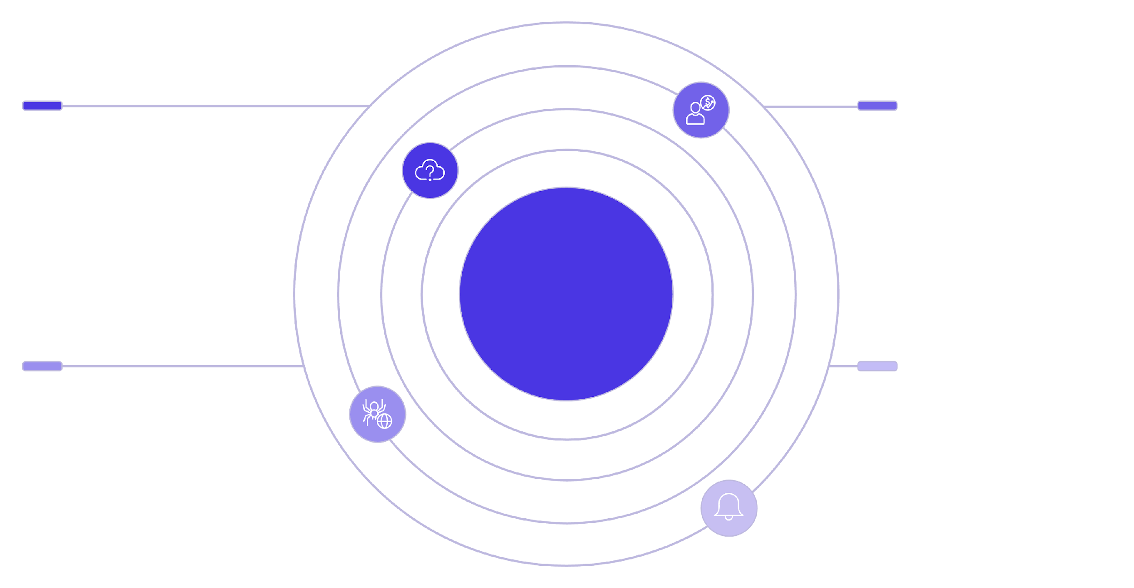




System Overview
Data Integration
Processing
Real-time weather data ingestion and APIs
Data analysis, forecasting, and alert criteria
Flood & Cyclone Early Warning System
Platform
Alert Delivery
Web application built with the MERN stack
Centralized notifications and user alerts

Slide 10



User Roles
Citizens
Authorities
Admins
Receive alerts, view weather data, subscribe to notifications, access safety guidelines.
Monitor live data, track notification status, generate disaster reports, and access all citizen functions.
Manage locations, data sources, alert thresholds, users, and system configurations.

Slide 11
Operating Environment
System Architecture
Database
Client/Server System
MongoDB (NoSQL, distributed)
Distributed Database
Platform
Operating System
MERN Stack (MongoDB, Express.js, React.js, Node.js)
Cross-Platform (Windows / Linux / macOS)

Slide 12

Thank You

